Slide 1
DECORATORS IN PYTHON
DVT101 – Lecture 22
- By Dataverse Tutorials

Slide 2
What are Decorators in Python?
Modify function behavior without changing code
Based on functions as objects
Clean and reusable design
Widely used in real projects

Slide 3
Decorator: Core Definition
Function that takes another function
Returns a new enhanced function
Uses wrapper pattern
No modification to original function

Slide 4
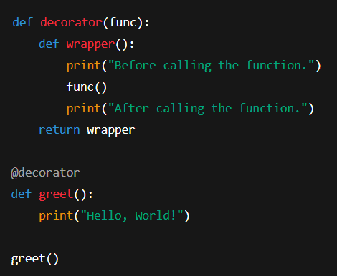
Basic Decorator Example
simple decorator that adds behavior
before and after a function call
visualize how decorators wrap existing functions

Slide 5
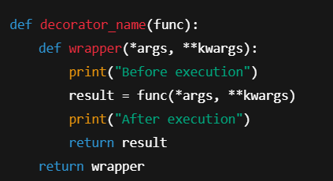
**Decorator with *args and kwargs
Handles any function signature
Flexible and reusable
Industry-ready pattern

Slide 6
Why Decorators are Possible?
Functions stored in variables
Functions passed as arguments
Functions returned from functions
Functions stored in data structures

Slide 7
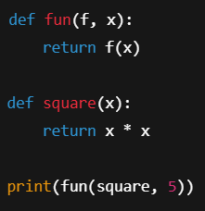
Higher-Order Functions
functions can accept other functions as arguments
return results, forming the foundation of decorators

Slide 8
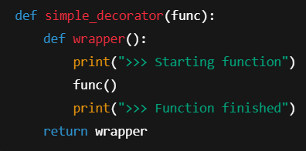
Function Decorators
Decorators enhance standalone functions
Injecting extra logic
Before and after execution

Slide 9
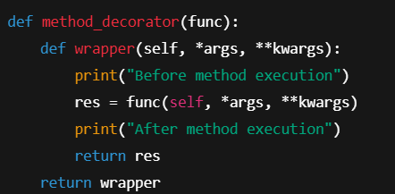
Method Decorators
Decorators applied to class methods
How self is handled inside wrapper functions

Slide 10

Class Decorators
Modify class behavior
Add attributes dynamically

Slide 11
Built-in Decorators
@staticmethod – no self
@classmethod – uses cls
@property – attribute-like access

Slide 12
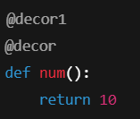
Chaining Decorators
Multiple decorators can be applied to the same function
Execution order affects output

Slide 13
Why Decorators Matter in Industry
Logging systems
Authentication & Authorization
API rate limiting
Caching (lru_cache)
Retry mechanisms

Slide 14
Key Takeaways
Decorators = functions wrapping functions
Clean & reusable logic
Built on first-class functions
Used heavily in production systems

Slide 15


